Slide 1
Sequential Circuit Design

Slide 2
Design Procedure
  Specification
  Formulation
    Obtain a state diagram or state table and determine the type (Mealy or Moore)
  State Assignment and Minimization
    Assign binary codes to the states and reduce them if possible
  Flip-Flop Input Equation Determination
    Select flip-flop types and derive flip-flop equations from next state entries in the table
  Output Equation Determination
    Derive output equations from output entries in the table
  Optimization
    Optimize the equations
  Technology Mapping
    Find circuit from equations and map to flip-flops and gate technology
  Verification
    Verify correctness of final design

Slide 3
Typical Sequential Circuit
Mealy Machine
C1
C2
s(t+1)
State Register
next
state
s(t)
x(t)
present
state
z(t)
present
inputs
clock

Slide 4
Typical Sequential Circuit
x
A
D
Q
Example
C
Q
A’
Next State
D
Q
B
CP
C
Q'
y
Output

Slide 5
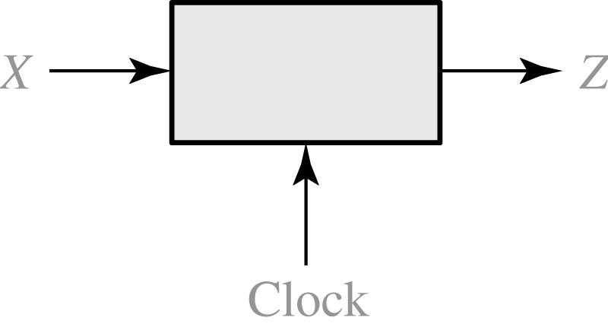
Sequence Detector
101 Sequence Detector
X = | 0 | 0 | 1 | 1 | 0 | 1 | 1 | 0 | 0 | 1 | 0 | 1 | 0 | 1 | 0 | 0
Z = | 0 | 0 | 0 | 0 | 0 | 1 | 0 | 0 | 0 | 0 | 0 | 1 | 0 | 1 | 0 | 0
(time: | 0 | 1 | 2 | 3 | 4 | 5 | 6 | 7 | 8 | 9 | 10 | 11 | 12 | 13 | 14 | 15)

Slide 6
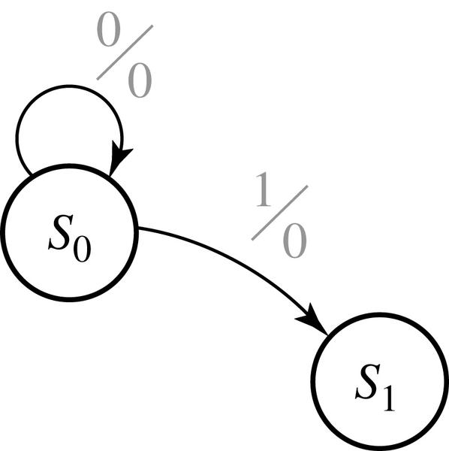
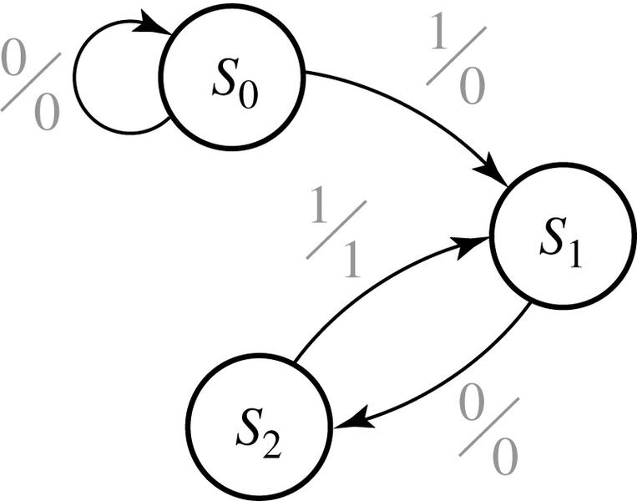
Design of 101 Sequence Detector
State Diagram:
1/0

Slide 7
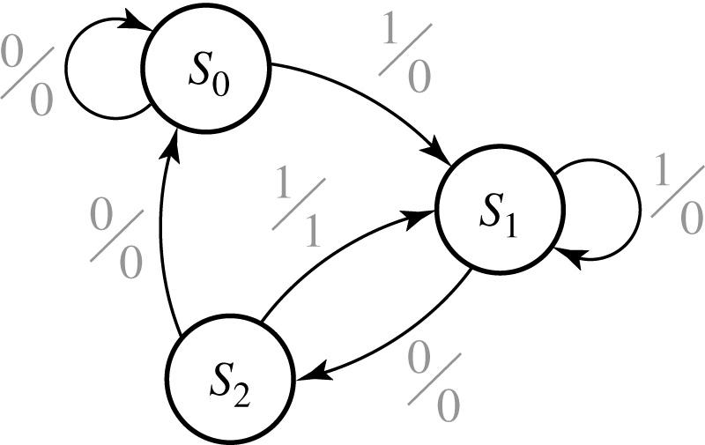
Design of 101 Sequence Detector
State Diagram (final):

Slide 8
Design of 101 Sequence Detector
State Table:
Present state |  | Next State |  | Output
 |  | X = 0 | X = 1 | X = 0 | X =1
S₀ S₁ S₂ |  | S₀ S₂ S₀ | S₁ S₁ S₁ | 0 0 0 | 0 0 1
State Table with State Assignment:
D_{A}
D_{B}
AB |  | A⁺ B⁺ |  | Z
 |  | X = 0 | X = 1 | X = 0 | X =1
00 01 10 |  | 00 10 00 | 01 01 01 | 0 0 0 | 0 0 1

Slide 9
Design of Sequence Detector
Derive Boolean Equations:
A
B
A
A
B
A
X
00
01
11
10
X
00
01
11
10
0
0
1
X
0
0
0
0
X
0
1
0
0
X
0
1
1
1
X
1
B
B
D_{A} = X’.B
D_{B} = X
A
A
B
X
00
01
11
10
0
0
0
X
0
Z = X.A
1
0
0
X
1
B

Slide 10
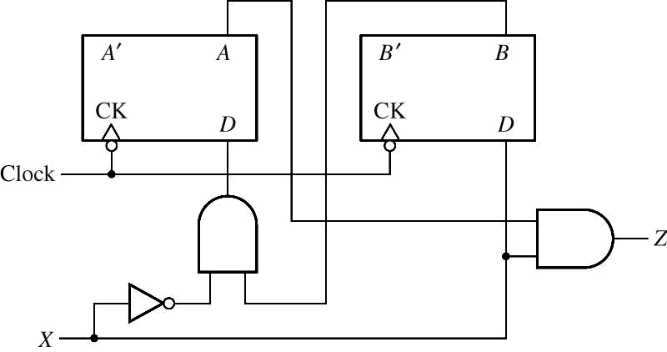
Design of Sequence Detector
C1
C2
State Register
s(t+1)
Compare with Typical Mealy Machine:
next
state
s(t)
x(t)
present
state
z(t)
present
inputs
clock

Slide 11
Design of Sequence Detector
A Moore Sequence Detector:
C2
C1
s(t+1)
z(t)
State Register
next
state
s(t)
x(t)
present
state
present
inputs
clock

Slide 12
Sequence Detector
101 sequence Detector
X = | 0 | 0 | 1 | 1 | 0 | 1 | 1 | 0 | 0 | 1 | 0 | 1 | 0 | 1 | 0 | 0
Z = | 0 | 0 | 0 | 0 | 0 | 1 | 0 | 0 | 0 | 0 | 0 | 1 | 0 | 1 | 0 | 0
(time: | 0 | 1 | 2 | 3 | 4 | 5 | 6 | 7 | 8 | 9 | 10 | 11 | 12 | 13 | 14 | 15)

Slide 13
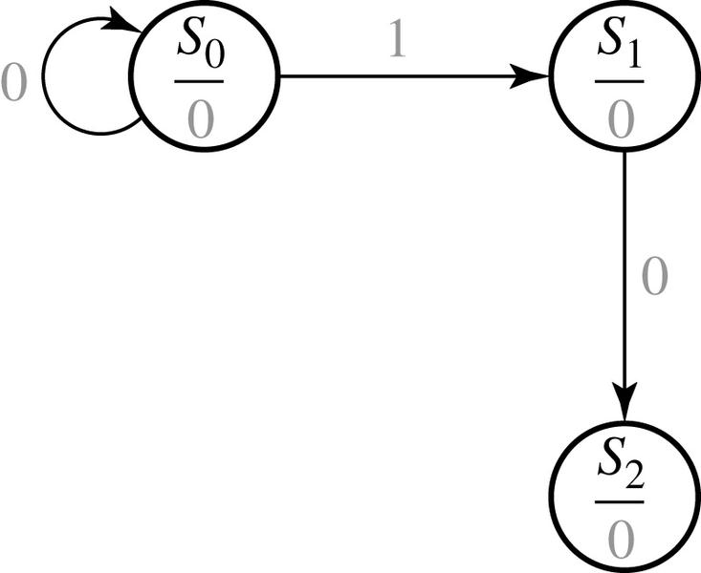
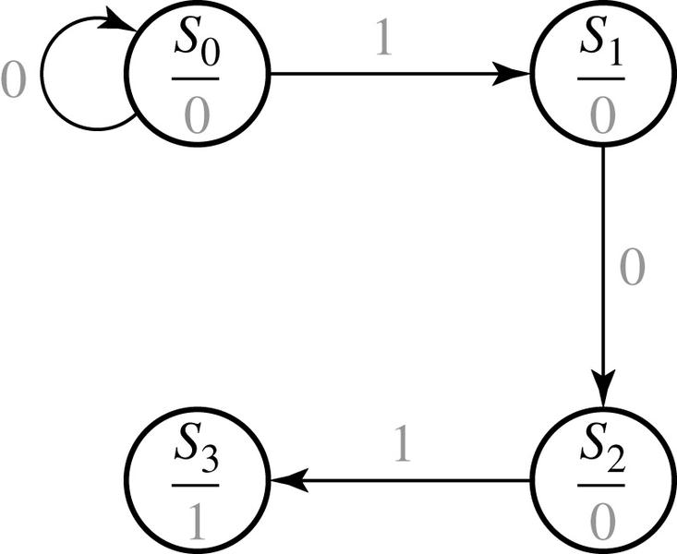
Design of a Sequence Detector
S₀: start
S₁: got 1
S₂: got 10
S₃: got 101

Slide 14
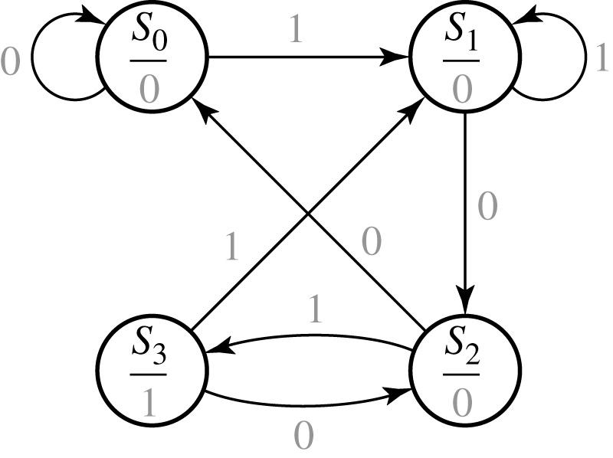
Design of a Sequence Detector
S₀: start
S₁: got 1
S₂: got 10
S₃: got 101

Slide 15
Design of a Sequence Detector
State Table
Transition Table with State Assignment
Present state |  | Next State |  | Output (Z)
 |  | X = 0 | X = 1
S₀ S₁ S₂ S₃ |  | S₀ S₂ S₀ S₂ | S₁ S₁ S₃ S₁ | 0 0 0 1
D_{A}
D_{B}
AB |  | A⁺ B⁺ |  | Z
 |  | X = 0 | X = 1
00 01 11 10 |  | 00 11 00 11 | 01 01 10 01 | 0 0 0 1

Slide 16
State Diagram Development
To develop a sequence detector state diagram:
  Construct some sample input and output sequences to make sure that you understand the problem statement.
  Begin in an initial state in which NONE of the initial portion of the sequence has occurred (typically “reset” state).
  Add a state that recognizes that the first symbol has occurred.
  Add states that recognize each successive symbol occurring.
  Each time you add an arrow to the state graph, determine it can go to one of the previously defined states or whether a new state must be added
  The final state represents the input sequence occurrence.
  Add state transition arcs which specify what happens when a symbol not in the proper sequence has occurred.
  Check your state graph for completeness and non-redundant arcs.
  When your state graph is complete, test it by applying the input sequences formulated in part1 and making sure the output sequences are correct

Slide 17
State Assignment
  Each of the m states must be assigned a unique code.
  Minimum number of bits (or flip-flops) required is n such that
  n ≥ log2 m
  where x is the smallest integer ≥ x.
  There may be 2^{n} - m unused states.
  There are useful state assignments that use more than the minimum number of bits.

Slide 18
Sequence Detector
Example: sequence 1101
Define states for the sequence to be recognized:
  assuming it starts with first symbol,
  continues through each symbol in the sequence to be recognized, and
  uses output 1 to mean the full sequence has occurred,
  with output 0 otherwise.
Starting in the initial state (Arbitrarily named "A"):
  Add a state that recognizes the first "1."
  The output symbol "0" means that the full recognized sequence has not yet occurred.
1/0
A
B

Slide 19
1101 Sequence Detector
After one more 1, we have:
  C is the state obtained when the input sequence has two "1"s.
Finally, after 110 and a 1, we have:
  Output 1 on the arc from D means the sequence has been recognized
  To what state should the arc from state D go? Remember: 1101101 ?
  Note that D is the last state but the output 1 occurs for the input applied in D. This is the case when a Mealy model is assumed.
A
1/0
1/0
B
C
1/0
1/0
0/0
1/1
A
B
C
D

Slide 20
1101 Detector
1/0
1/0
0/0
1/1
A
B
C
D
  Clearly the final 1 in the recognized sequence 1101 is a sub-sequence of 1101.
  It follows a 0 which is not a sub-sequence of 1101.
    Thus it should represent the same state reached from the initial state after a first 1 is observed. We obtain:
1/0
1/0
0/0
A
B
C
D
1/1

Slide 21
1101 Detector
1/0
1/0
0/0
A
B
C
D
1/1
The states have the following abstract meanings:
  A: No proper sub-sequence of the sequence has occurred.
  B: The sub-sequence 1 has occurred.
  C: The sub-sequence 11 has occurred.
  D: The sub-sequence 110 has occurred.
  The 1/1 on the arc from D to B means that the last 1 has occurred and thus, the sequence is recognized.

Slide 22
1101 Detector
  The other arcs are added to each state for inputs not yet listed. Which arcs are missing?
  Answer:
  "0" arc from A
  "0" arc from B
  "1" arc from C
  "0" arc from D.
1/0
1/0
0/0
A
B
C
D
1/1

Slide 23
1101 Detector
  Note that the 1 arc from state C to state C implies that State C means two or more 1's have occurred.
0/0
1/0
1/0
1/0
0/0
A
B
C
D
0/0
1/1
0/0

Slide 24
1101 Detector
  From the State Diagram, we can fill in the State Table.
  There are 4 states, one input, and one output. We will choose the form with four rows, one for each current state.
  From State A, the 0 and 1 input transitions have been filled in along with the outputs.
0/0
0/0
1/0
1/0
1/0
0/0
1/0
A
B
C
D
0/0
1/1
0/0
Present
Next State
Output
State
x=0 x=1
x=0 x=1
A
A
B
0
0
B
C
D

Slide 25
1101 Detector: State Table
0/0
1/0
A
1/0
B
1/0
C
0/0
D
0/0
1/1
0/0
Present
Next State
Output
State
x=0 x=1
x=0 x=1
A
A B
0 0
B
A C
0 0
C
D C
0 0
D
A B
0 1
      What would the state diagram and state table look like for the Moore model?

Slide 26
Sequence Detector: Moore Model
  For the Moore Model, outputs are associated with states.
  We need to add a state "E" with output value 1 for the final 1 in the recognized input sequence.
    This new state E, though similar to B, would generate an output of 1 and thus be different from B.
  The Moore model for a sequence recognizer usually has more states than the Mealy model.

Slide 27
Sequence Detector: Moore Model
  We mark outputs on states for Moore model
  Arcs now show only state transitions
  Add a new state E to produce the output 1
  E produces the same behavior in the future as state B. But it gives a different output at the present time.
0
1
1
1
0
A/0
B/0
C/0
D/0
0
1
1
0
E/1
0

Slide 28
Sequence Detector: Moore Model
  The state table is shown below
  More state in the Moore model: “Moore is More.”
0
1
1
1
0
A/0
B/0
C/0
D/0
0
1
1
0
E/1
Present
Next State
Output
0
State
x=0 x=1
y
A
A
B
0
B
A
C
0
C
D
C
0
D
A
E
0
E
A
C
1

Slide 29
State Assignment: Example 1
Present
Next State
Output
State
x=0 x=1
x=0 x=1
A
A
B
0
0
B
A
B
0
1
  How may assignments of codes with a minimum number of bits?
    Two: A = 0, B = 1 or A = 1, B = 0
  Does it make a difference?
    Only in variable inversion, so small, if any.

Slide 30
State Assignment: Example 2
Present
Next State
Output
State
x=0 x=1
x=0 x=1
A
A B
0 0
B
A C
0 0
C
D C
0 0
D
A B
0 1
  How may assignments of codes with a minimum number of bits?
    4 × 3 × 2 × 1 = 24
  Does code assignment make a difference in cost?
  Probably yes!

Slide 31
State Assignment: Example 2
  Assignment 1:
    A = 0 0, B = 0 1, C = 1 0, D = 1 1
  The resulting coded state table:
Present State | Next State x = 0 x = 1 |  | Output x = 0 x = 1
0 0 | 0 0 | 0 1 | 0 | 0
0 1 | 0 0 | 1 0 | 0 | 0
1 0 | 1 1 | 1 0 | 0 | 0
1 1 | 0 0 | 0 1 | 0 | 1

Slide 32
State Assignment: Example 2
  Assignment 2:
    A = 0 0, B = 0 1, C = 1 1, D = 1 0
  The resulting coded state table:
Present State | Next State x = 0 x = 1 |  | Output x = 0 x = 1
0 0 | 0 0 | 0 1 | 0 | 0
0 1 | 0 0 | 1 1 | 0 | 0
1 1 | 1 0 | 1 1 | 0 | 0
1 0 | 0 0 | 0 1 | 0 | 1

Slide 33
Flip-Flop Input and Output Equations: Example 2 (version 1)
  Assume D flip-flops
  Interchange the bottom two rows of the state table, to obtain K-maps for D_{A}, D_{B}, and Z:
A
B
A
A
B
A
X
00
01
11
10
X
00
01
11
10
0
0
0
0
1
0
0
0
0
1
1
0
1
0
1
1
1
0
1
0
B
B
D_{A} = A.B’ + X.A’.B
D_{B} = X’.A.B’ + X.A’.B’+X.A.B

Slide 34
Flip-Flop Input and Output Equations: Example 2 (version 1)
A
B
A
X
00
01
11
10
0
0
0
0
0
1
0
0
1
0
B
Z = A.B.X
Gate Input Cost = 22

Slide 35
Flip-Flop Input and Output Equations: Example 2 (version 2)
  Assume D flip-flops
  Interchange the bottom two rows of the state table, to obtain K-maps for D_{A}, D_{B}, and Z:
A
B
A
A
B
A
X
00
01
11
10
X
00
01
11
10
0
0
0
1
0
0
0
0
0
0
1
0
1
1
0
1
1
1
1
1
B
B
D_{A} = A.B + X.B
D_{B} = X

Slide 36
Flip-Flop Input and Output Equations: Example 2 (version 2)
A
B
A
X
00
01
11
10
0
0
0
0
0
1
0
0
0
1
B
Z = A.B’.X
Gate Input Cost = 9
Select this state assignment!

Slide 37
Implementation
Initial Circuit:
Library:
  D Flip-flops
  with Reset
  (not inverted)
  NAND gates
  with up to 4
  inputs
  Inverters
D
Y₁
C
R
Z
Y₂
X
D
Clock
C
R
Reset

Slide 38
Technology Mapping
Y₁
D
C
R
Z
Y₂
X
D
Clock
C
R
Reset

Slide 39
Design Example: Vending Machine
General Machine Concept:
  Deliver a package of gum after 15 cents deposited
  Single coin slot for dimes (10¢) and nickels (5¢)
  No change

Slide 40
Example: Vending Machine
Step 1: Understand the problem:
  Draw a block diagram
5¢
Coin
Vending
Gum
Sensor
10¢
Open
Machine
Release
Reset
FSM
Mechanism
Clk

Slide 41
Example: Vending Machine
Step 2: Draw state diagram:
  All possible sequences
    Inputs: N, D, reset
    Output: open
Reset
S0
N
D
S1
S2
Dime: 10¢
Nickel: 5¢
N
D
N
D
Notes:
  If neither N nor D, goes to itself.
  Both N and D is not possible.
S3
S4
S5
S6
[open]
[open]
[open]
N
D
S7
S8
[open]
[open]

Slide 42
Example: Vending Machine
Step 3: State minimization:
  Reuse states whenever possible
Reset
0¢
N
Dime: 10¢
Nickel: 5¢
5¢
D
N
10¢
D
N, D
15¢
[open]

Slide 43
Example: Vending Machine
Step 4: Symbolic state table:
Present
Inputs
Next
Output
State
D
N
State
Open
Reset
0¢
0
0
0¢
0
0¢
0
1
5¢
0
1
0
10¢
0
N
1
1
X
X
5¢
5¢
0
0
5¢
0
D
0
1
10¢
0
N
1
0
15¢
0
10¢
1
1
X
X
D
10¢
0
0
10¢
0
0
1
15¢
0
N, D
1
0
15¢
0
15¢
1
1
X
X
[open]
15¢
X
X
15¢
1
From 15¢ state, you may want to go to reset state

Slide 44
Example: Vending Machine
Step 5: State assignment/encoding:
Present State
Inputs
Next State
Output
Q
1
Q
0
D
N
D
1
D
0
Open
0
0
0
0
0
0
0
0
1
0 1
0
1
0
1 0
0
1
1
X X
X
0 1
0
0
0 1
0
0
1
1 0
0
1
0
1 1
0
1
1
X X
X
1 0
0
0
1 0
0
0
1
1 1
0
1
0
1 1
0
1
1
X X
X
1 1
0
0
1 1
1
0
1
1 1
1
1
0
1 1
1
1
1
X X
X

Slide 45












Example: Vending Machine
Step 6: Choose FF for implementation:
  DFF: easiest
Q1 Q0
Q1
Q1 Q0
Q1
Q1 Q0
Q1
D N
D N
D N
0 0 1 1
0 1 1 0
0 0 1 0
0 1 1 1
1 0 1 1
0 0 1 0
N
N
N
X X X X
X X X X
X X X X
D
D
D
1 1 1 1
0 1 1 1
0 0 1 0
Q0
Q0
Q0
K-map for D1
K-map for D0
K-map for Open
Q
1
D
Q
D
1
D
Q
1
Q
CLK
Q
\
Q
D1 = Q1 + D + Q0 N
D0 = N Q0’ + Q0 N’ + Q1 N + Q1 D
OPEN = Q1 Q0
0
R
1
N
\reset
\
Q
N
OPEN
0
Q
\
0
N
D
D
Q
Q
Q
0
0
1
CLK
Q
\
Q
N
R
0
8 Gates
Q
\reset
1
D

Slide 46
Equivalence of Moore and Mealy Machines
Moore
Machine
N D + Reset
(N D + Reset)/0
Mealy
Machine
Reset
Reset/0
0¢
0¢
[0]
Reset
N
Reset/0
N/0
5¢
5¢
N D
D
N D/0
D/0
[0]
N
N/0
10¢
10¢
D
D/1
[0]
N D
N D/0
N+D
N+D/1
15¢
15¢
[1]
Reset
Reset/1
Outputs are associated
with the states
Outputs are associated
with the transitions

Slide 47
Using Other FFs for Design
Characteristic Table:
  Defines the next state of the flip-flop in terms of flip-flop inputs and current state.
    Used in Circuit Analysis
Excitation Table:
  Defines the flip-flop input variable values as function of the current state and next state.
    Used in Circuit Design

Slide 48
SR FF Tables
Characteristic Table:
S
R
Q(t
+
1)
Operation
0
0
Q(t)
No change
0
1
0
Reset
1
0
1
Set
1
1
?
Undefined
Excitation Table:
Q(t)
Q(t+
1)
S
R
Operation
0
0
0
X
No change/Reset
0
1
1
0
Set
1
0
0
1
Reset
1
1
X
0
No change/Set

Slide 49
DFF Tables
Characteristic Table:
D
Q(t
+
1)
Operation
0
0
Reset
1
1
Set
Excitation Table:
Q(t)
Operation
Q(t
+1)
D
x
0
0
Reset
x
1
1
Set

Slide 50
JK FF Tables
Characteristic Table:
J
K
Q(t+1)
Operation
0
0
Q(t)
No change
0
1
0
Reset
1
0
1
Set
1
1
Q(t)
Complement
Excitation Table:
Q(t)
Q(t+1)
J
K
Operation
0
0
0
X
No change/Reset
0
1
1
X
Set/Toggle
1
0
X
1
Reset/Toggle
1
1
X
0
No Change/Set

Slide 51
T FF Tables
Characteristic Table:
T
Q(t+1)
Operation
0
Q(t)
No change
1
Q(t)
Complement
Excitation Table:
Q(t)
Q(t+1)
T
Operation
0
0
0
No change
0
1
1
Toggle
1
0
1
Toggle
1
1
0
No Change

Slide 52
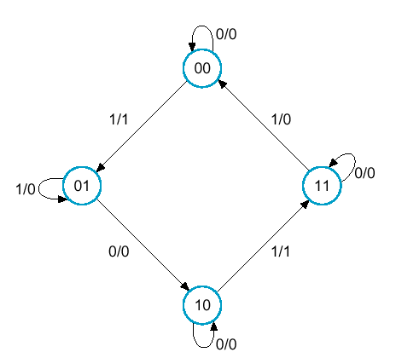
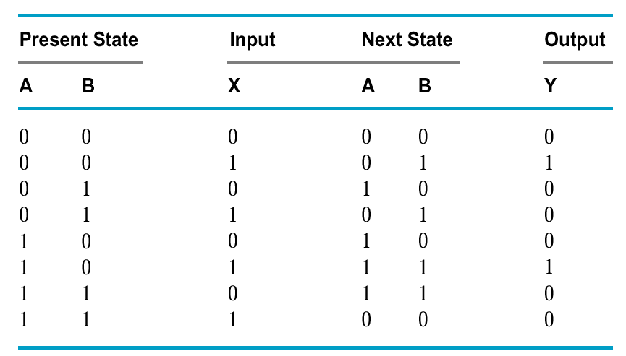
Example
Design by DFF

Slide 53



Example
A(t + 1) = DA(A,B,X) = Σ m(2,4,5,6)
B(t + 1) = DB(A,B,X) = Σ m(1,3,5,6)
Y(A,B,X) = Σ m(1,5)
BX
A
BX
A
DA = AB + BX
DB = AX + BX + ABX
BX
A
Y = BX

Slide 54
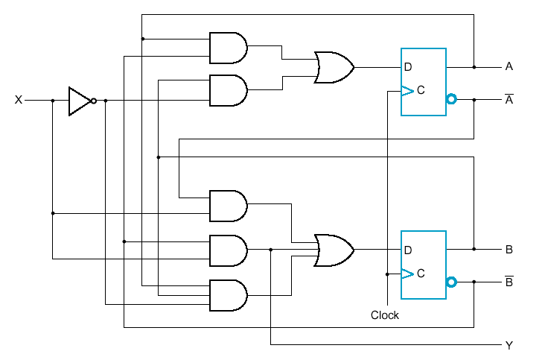
Example
  Logic Diagram for Circuit with D Flip-Flops

Slide 55
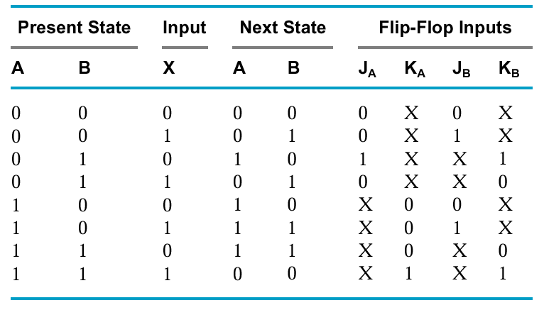
Example
Design by JK FF
Q(t)
Q(t+1)
J
K
Operation
0
0
0
X
No change/reset
0
1
1
X
Set/Toggle
1
0
X
1
Reset/Toggle
1
1
X
0
No change/set
  Don’t cares
    lead to simpler combinational circuit

Slide 56
Example: Boolean Equations
JA = BX JB = X
KA = BX KB = AX + AX

Slide 57
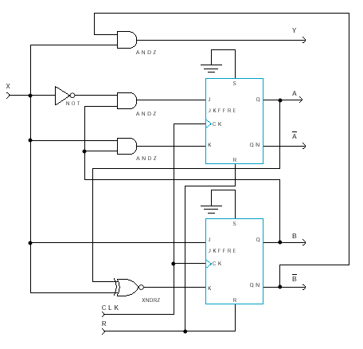
Example: Logic Diagram

